Slide 1
Effects on Mental Health of Health Care Workers Due to CovID19
GROUP MEMBERS
MUBASHIR ALI MSDS20085
QAZI DANISH AYUB MSDS20075
ABDULLAH AZIZ MSDS20052

Slide 2
Motivation
Medical workers are the frontline for this fight against a pandemic
During these hard times a lot of other different factors make things more stressful
Non availability of beds, shortage of ICU/Medications
People are out of jobs, businesses are closed, self-isolated with fear of unknown.
Improper lockdown policies
Non-serious attitude of general public about social distancing, sanitization measures
Rising number of cases

Slide 3
Observations
In other parts of the world an increase in following mental conditions were observed
Anxiety
Stress
Insomnia
Depression

Slide 4
Methodology
Designing the Questionnaire (based on DASS21)
Data Collection(online survey & manually)
Compiling data from different sources & visualization
Deciding Distribution of data (by visualization; histograms, box plots, mean median)
Preprocessing
Analyzing Data (removing unwanted columns)
Statistical analysis/ population parameters estimation, confidence interval

Slide 5
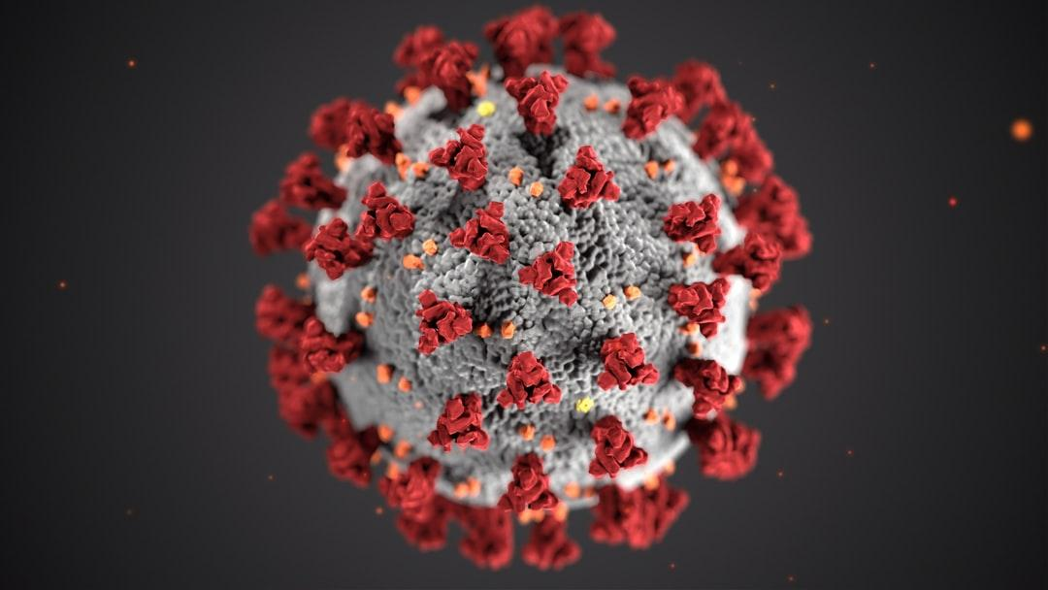
Methodology
Designing Questionnaire (Dass21)
Distributing the questionnaire
Online/Manually
Compiling responses
Preprocessing
Normalization/Standardization
Transformations
Data Visualization
Statistical Analysis
Population parameters estimation
Confidence Interval

Slide 6
Questionnaire for mental disorder diagnosis(DASS21)
It is a set of three self-report scales designed to measure the negative emotional states of:
depression
anxiety
stress

Slide 7
Dass 21
The rating scale is as follows:
0 Did not apply to me at all.
1 Applied to me to some degree.
2 Applied to a considerable degree
3 Applied to me very much of the time
1 | I found it hard to wind down | 0 | 1 | 2 | 3
2 | I was aware of dryness of my mouth | 0 | 1 | 2 | 3
3 | I couldn’t seem to experience any positive feeling at all | 0 | 1 | 2 | 3
4 | I experienced breathing difficulty(e.g. excessively rapid breathing breathlessness in the absence of physical exertion) | 0 | 1 | 2 | 3
5 | I found it difficult to work up the initiative to do things | 0 | 1 | 2 | 3
6 | I tended to over react to situations | 0 | 1 | 2 | 3

Slide 8
Dass 21 Scoring Table
Scores for depression, anxiety and stress are calculated by summing the scores for the relevant items and compared with their severity.
Level | Depression | Anxiety | Stress
Normal | 0-9 | 0-7 | 0-14
Mild | 10-13 | 8-9 | 15-18
Moderate | 14-20 | 10-14 | 19-25
Severe | 21-27 | 15-19 | 26-33
Extreme Severe | 28 | 20 | 34

Slide 9
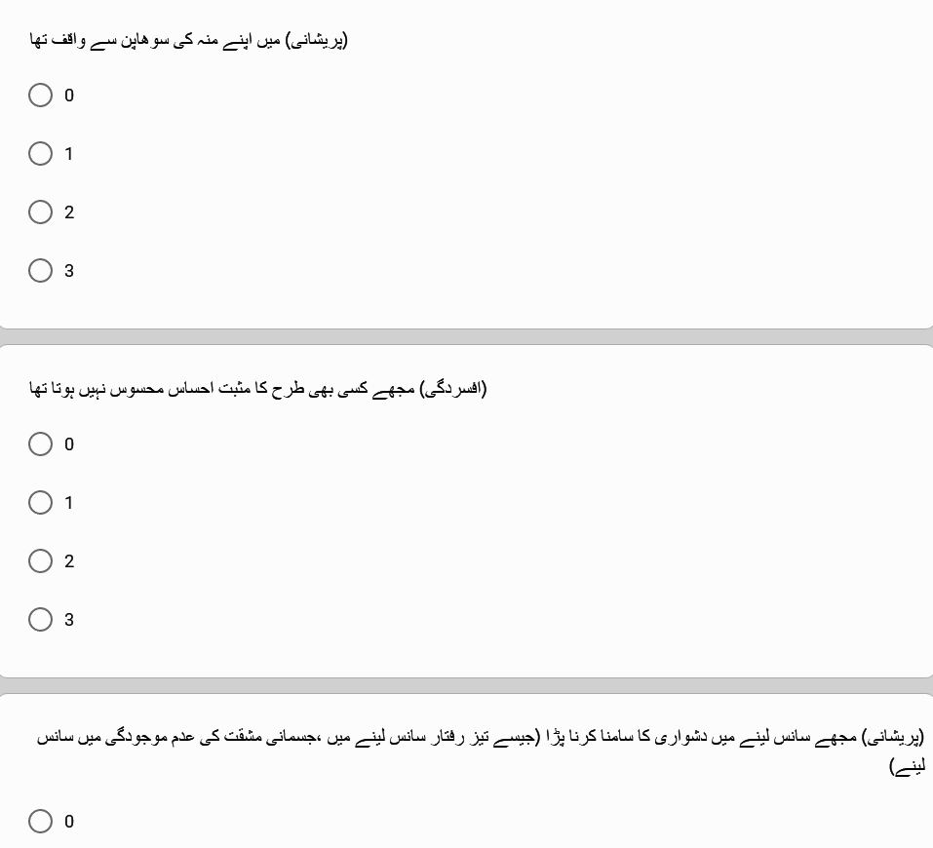
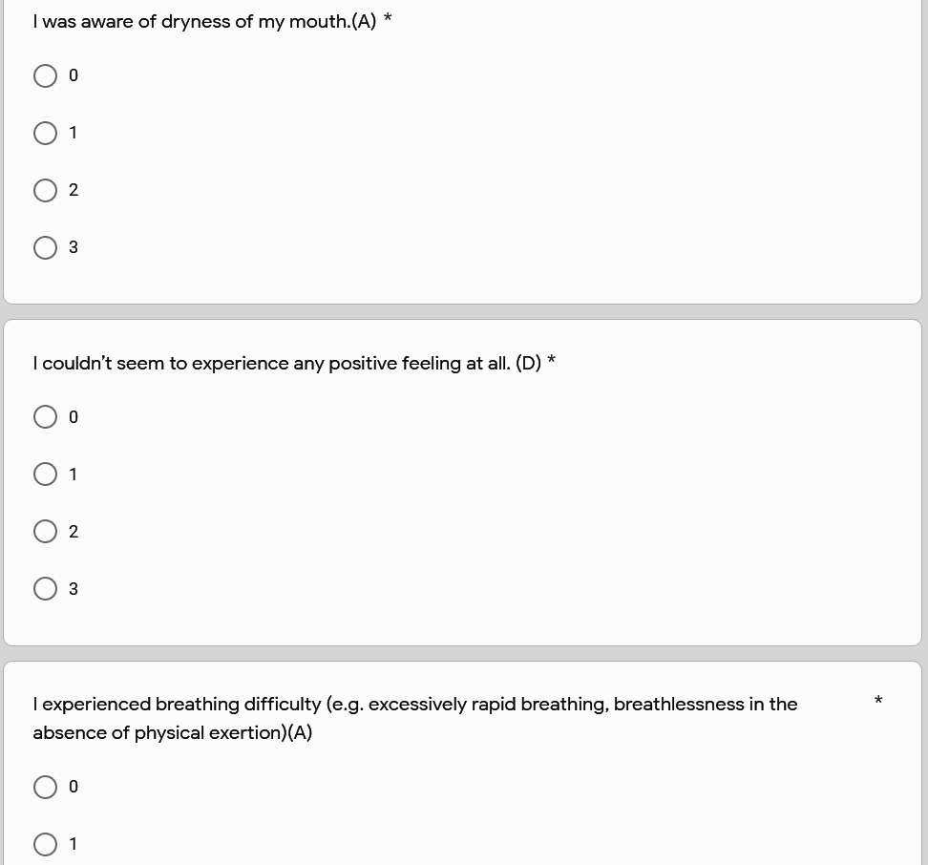
Questionnaire Sample
A sample for questionnaire
English version
Urdu version

Slide 10

Data Collection
Designing Questionnaire(keeping questions as simple as possible)
Personal Information
Dass 21
Manually Visiting Hospital
Online form design
Online Survey
Translation of questionnaire

Slide 11
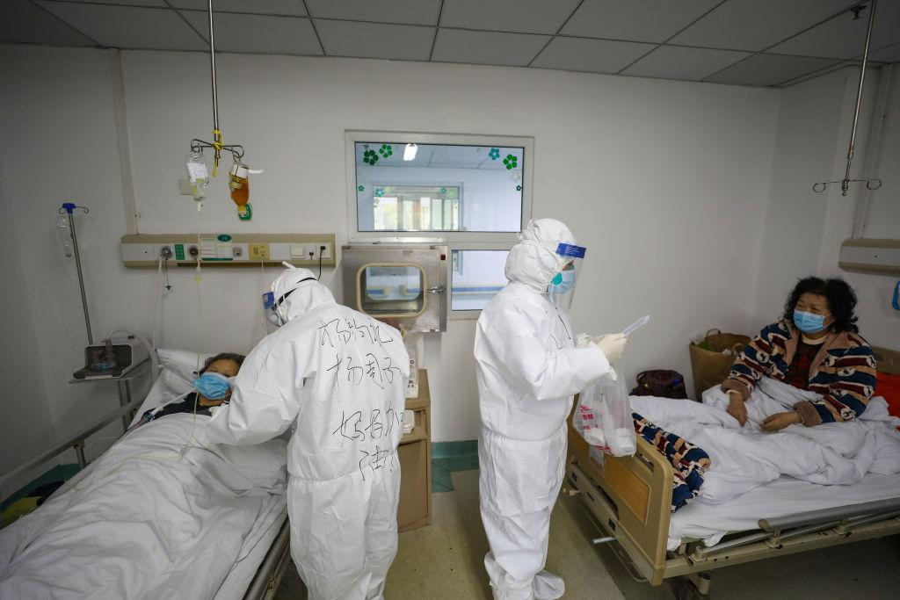
Issues in Data Collection
Reaching out to doctors for participation
Making sure enough responses are collected
literacy comprehension barrier
Getting affected with corona
Doctors were not willing to meet

Slide 12
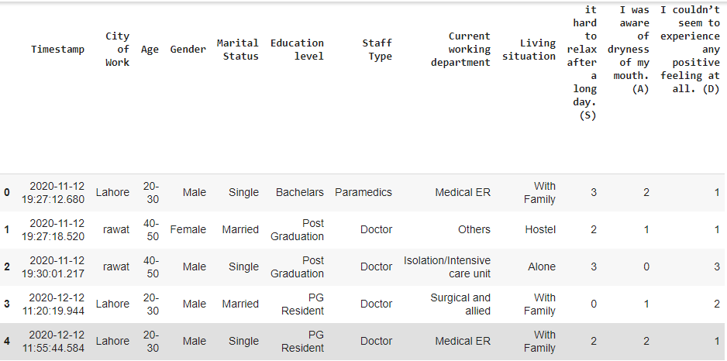
Actual Dataset

Slide 13
Data Preprocessing
Compiling data obtained from different sources
Data visualization
Analyzing Data
Conversion of question into variable
Standardizing names of cities
Dropping unwanted columns
Cities | Label
multan, mulltan, Layyah, Kahror Pacca | Multan
lahore, Lahorw, Lhr, Lahore | Lahore
Rawalpindi, Rawalpindi, Rawal pindi ,rawalpindu, Rwp, Rawalpi di, Pindi, Chakwal, rawat | Rawalpindi
Islambad, Islamabad, Isb, islamabad | Islamabad
Mirpur azad Kashmir, Bhimber AJK | AJK
Sialkot, Gujrat | Sialkot
Khushab, Sargodha | Sargodha
Karachi | Karachi

Slide 14
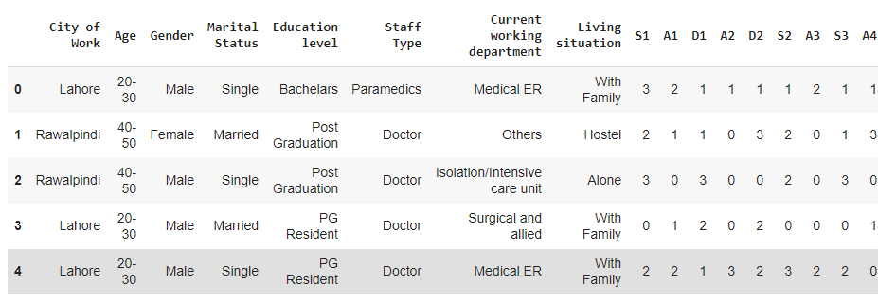
Preprocessed Form of Dataset

Slide 15
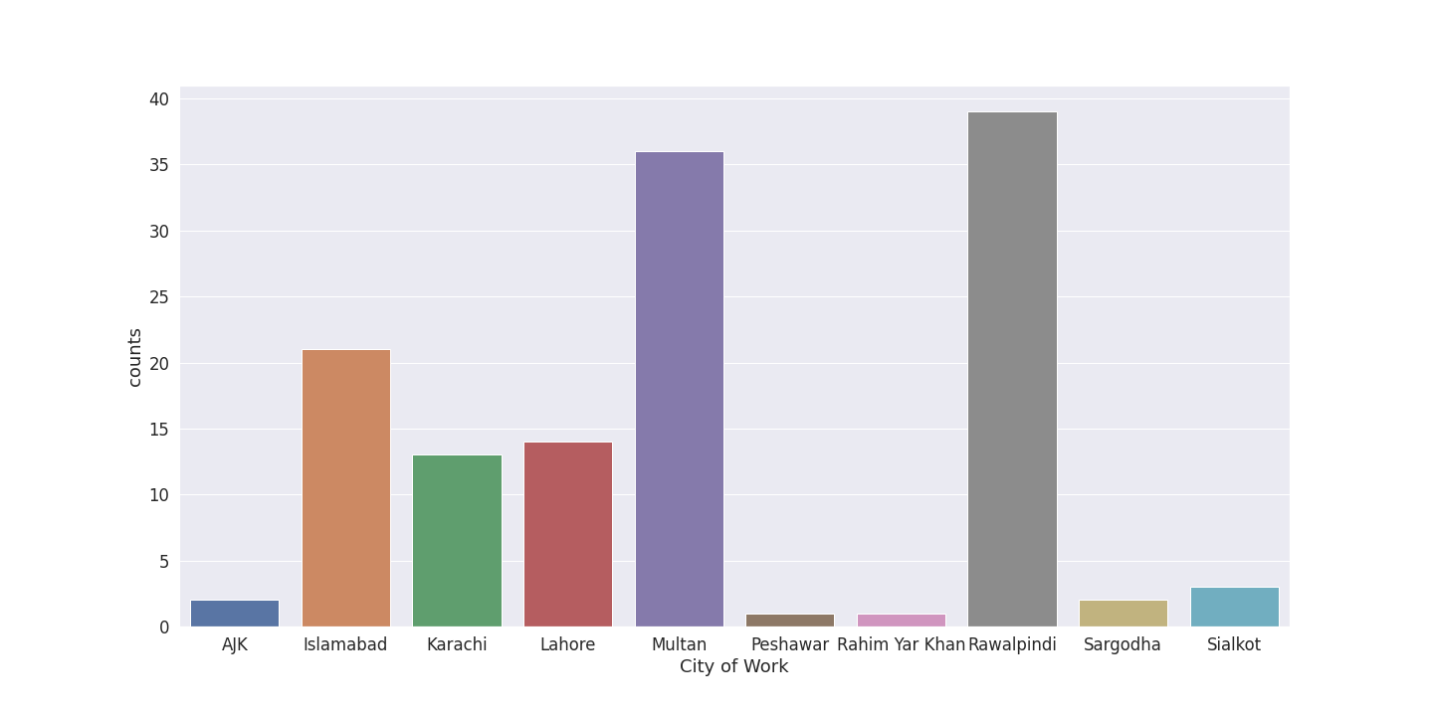
Data Visualization(Participant Cities)

Slide 16
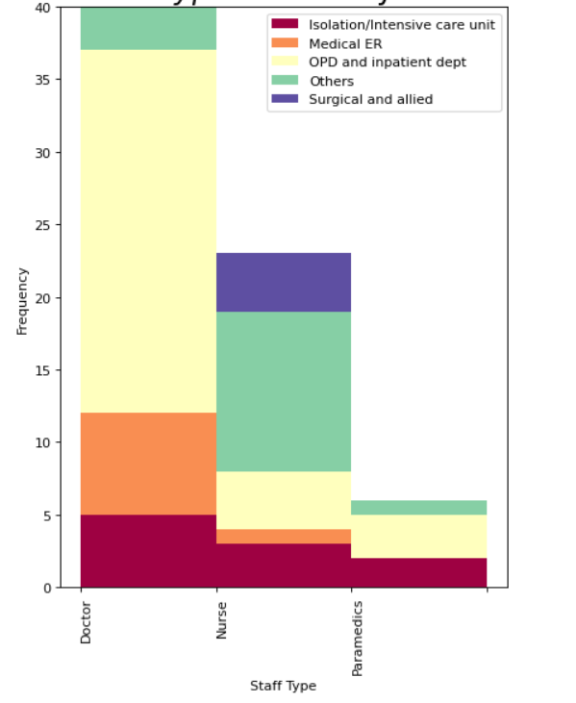
Data Visualization
The participants belong to 3 major categories of
healthcare workers:
Doctor
Nurses
Paramedics
Working in different departments of respective hospitals

Slide 17
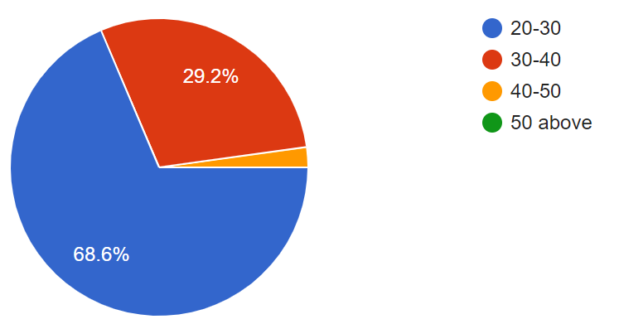
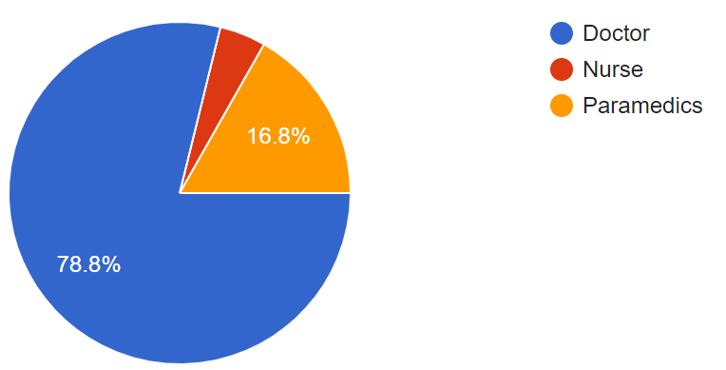
Data Visualization
68.6% of people have age between 20-30
29.2% of people have age between 30-40
78.8% of people were doctors
16.8% of people are Paramedics
Age
Staff Type

Slide 18
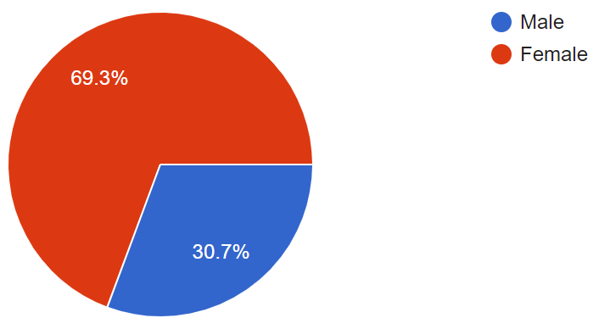
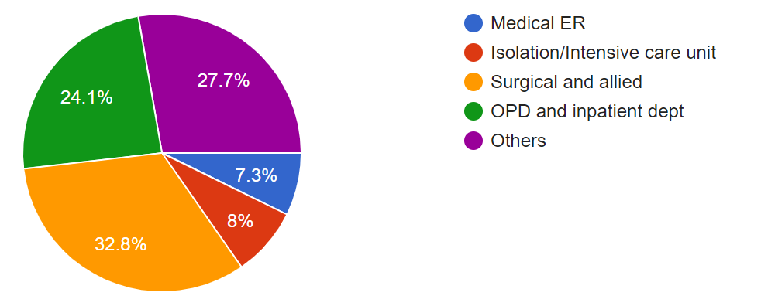
Data Visualization
69.3% of people are Female
30.7% of people are Male
32.8% people works in Surgical and allied
24.1% people works in OPD
7.3% of people works in Medical ER
Gender
Current Working Department

Slide 19
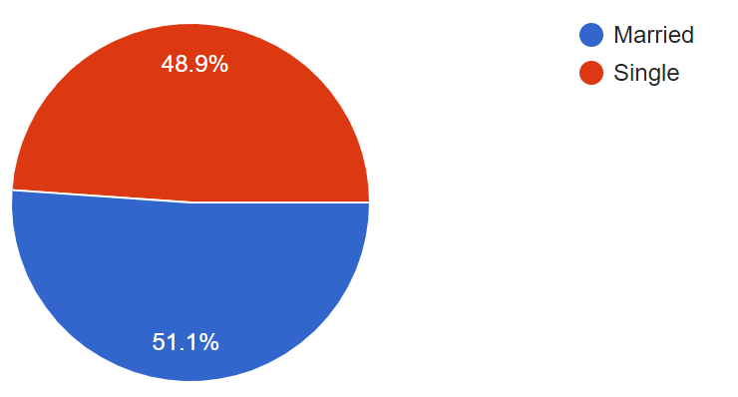
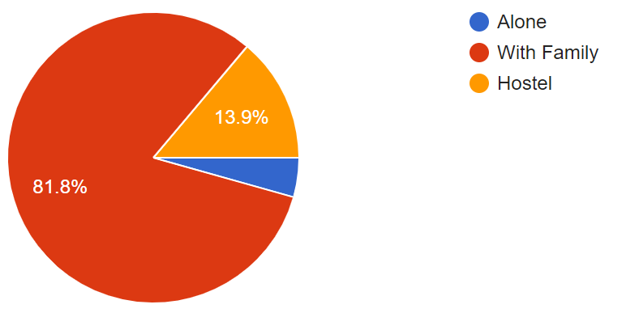
Data Visualization
48.9% of people are single
51.1% of people married
48.9% of people are single
51.1% of people married
Marital Status
Living Situation

Slide 20
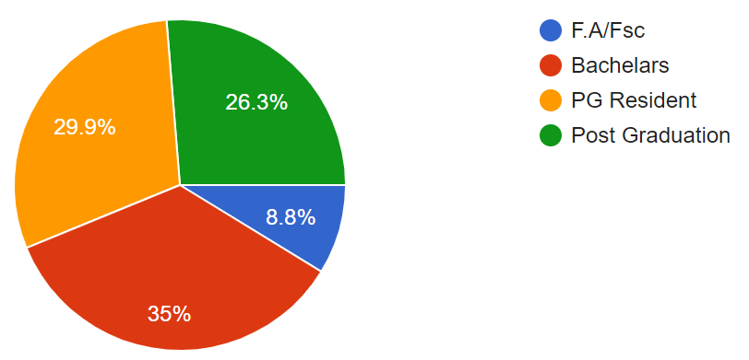
Data Visualization
35% of people are Bachelors
29.9% of people are PG Resident
26.3% of people are Post Graduated
8.8% of people are F.A/Fsc
Education

Slide 21
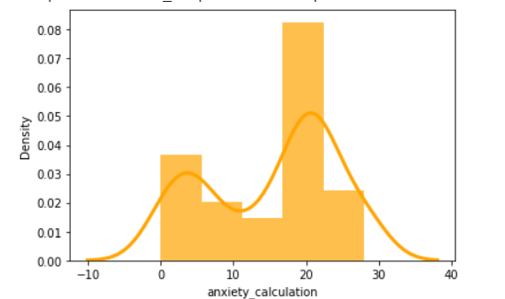
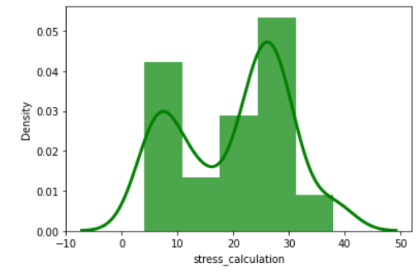
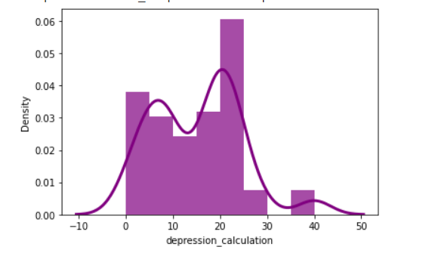
Results Dass 21
Anxiety Distribution
Stress Distribution
Depression Distribution

Slide 22
Mean Median & STD
Mental Disorder | Mean | Median | STD
Depression | 14.43 | 14.0 | 9.38
Anxiety | 12.63 | 12.0 | 9.06
Stress | 17.06 | 16.0 | 9.70

Slide 23
Result of Confidence Interval with 5% significance level
Mental Disorder | significance level | Lower Level | Upper Level | Severity
Depression | 5% | 12.82 | 16.05 | Mild, Moderate
Anxiety | 5% | 11.07 | 14.19 | Moderate
Stress | 5% | 15.38 | 18.73 | Mild

Slide 24
Results: Different Groups of Participant Population
Mental Disorder | Gender | significance level | Lower Level | Upper Level | Severity
Stress | Male | 5% | 12.3 | 19.49 | Normal, Mild, Moderate
Anxiety | Male | 5% | 8.52 | 15.04 | Mild, Moderate Severe
Depression | Male | 5% | 10.9 | 16.78 | Mild, Moderate
Stress | Female | 5% | 15.7 | 19.45 | Mild, Moderate
Anxiety | Female | 5% | 11.2 | 14.81 | Moderate,Severe
Depression | Female | 5% | 12.7 | 16.68 | Mild, Moderate
Mental Disorder | Marital Status | Confidence Level | Lower Level | Upper Level | Severity
Stress | Single | 5% | 15.21 | 19.82 | Mild, Moderate
Anxiety | Single | 5% | 11.03 | 15.29 | Moderate Severe
Depression | Single | 5% | 13.73 | 18.32 | Moderate Severe
Stress | Married | 5% | 14.04 | 19.06 | Mild, Moderate
Anxiety | Married | 5% | 9.75 | 14.42 | Mild, Moderate
Depression | Married | 5% | 10.56 | 15.07 | Mild, Moderate

Slide 25
Results: Different Groups of Participant Population
Mental Disorder | City | Significance level | Lower Level | Upper Level | Severity
Stress | Lahore | 5% | 7.3325 | 21.8103 | Normal,Mild, Moderate
Anxiety | Lahore | 5% | 5.6281 | 17.5147 | Normal,Mild Moderate,Severe
Depression | Lahore | 5% | 5.4987 | 15.6440 | Normal,Mild,Moderate
Stress | Islamabad & Rawalpindi | 5% | 16.7224 | 21.5442 | Mild,Moderate
Anxiety | Islamabad & Rawalpindi | 5% | 11.1545 | 15.9121 | Moderate,Severe
Depression | Islamabad & Rawalpindi | 5% | 11.1545 | 18.1805 | Mild,Moderate
Stress | Multan | 5% | 12.2317 | 19.4555 | Normal,Mild,Moderate
Anxiety | Multan | 5% | 9.2001 | 14.1332 | Mild,Moderate
Depression | Multan | 5% | 11.8113 | 15.9664 | Mild,Moderate

Slide 26
Conclusion
After the evaluation and calculations on this data we find that the levels of stress, anxiety and depression among the medical health care workers were not normal but there were elevated levels of mental health disorder.
Further the data is divided into smaller groups of participants to further analyze the mental health of medical workers.

Slide 27
References
[1] K. K. Wu, S. K. Chan, and T. M. Ma, “Posttraumatic stress after SARS.
[2] J. Lai et al., “Factors Associated With Mental Health Outcomes Among Health Care Workers Exposed to Coronavirus Disease 2019.
[3] R. Rossi et al., “Mental Health Outcomes Among Frontline and Second-Line Health Care Workers During the Coronavirus Disease 2019 (COVID-19) Pandemic in Italy.
[4] S. S. Chatterjee, R. Bhattacharyya, S. Bhattacharyya, S. Gupta, S. Das, and B. B. Banerjee, “Attitude, practice, behavior, and mental health impact of COVID-19 on doctors.
[5] F. Shahzad et al., “Perceived Threat of COVID-19 Contagion and Frontline Paramedics’ Agonistic Behaviour: Employing a Stressor–Strain–Outcome Perspective.

Slide 28
THANKYOU!!

